Slide 1

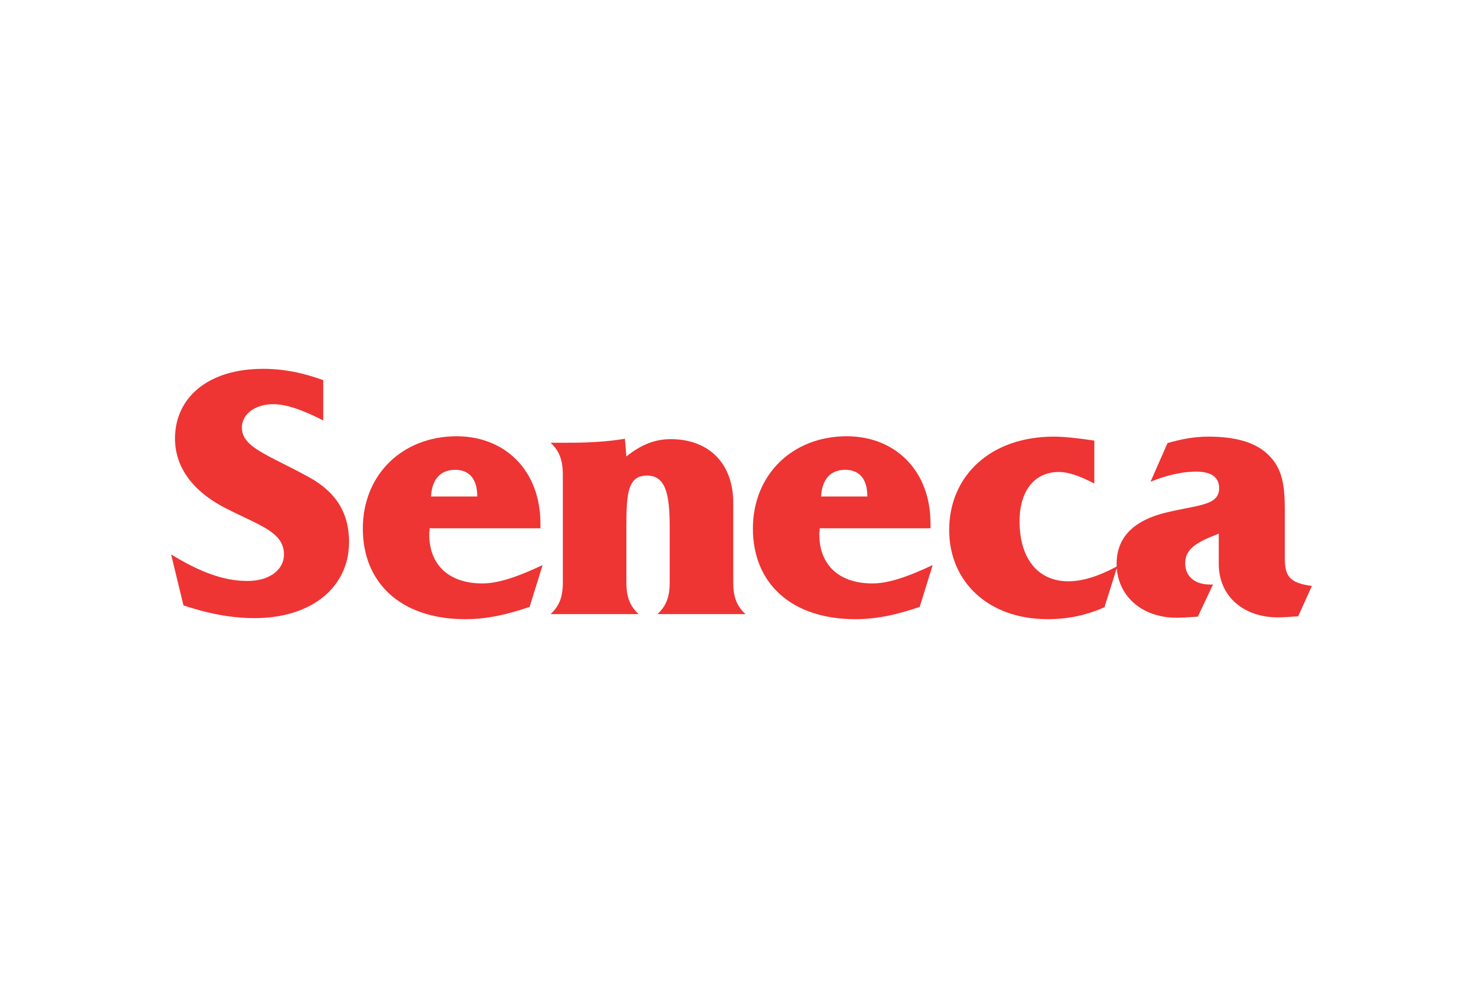
Green Horizons: Predictive Analytics for Optimal Cannabis Store Locations
Group 5
Mohammad Daniyal (118877208)
Karanjeet Singh Makker (167789213)
Muhammad Arsalan Shams (130518228)
Pareen Suresh Harsosa (112515226)
Priyavrat Mehla (152453213)
Oluwafunmilayo Atinuke Oke (116727223)
BAN210ZCC
Project 2

Slide 2


Company Overview & Key Stakeholders
Richard Boire Inc.:
Industry: Cannabis Retail & Distribution
Founded: 1999
Headquarters: Vancouver, BC
Vision: To be the leading cannabis retailer in Ontario
Key Stakeholders:
Richard Boire: Founder & President, driving force behind the company's strategic decisions
Elena Smith: Chief Financial Officer, oversees company's financial strategies
Michael Chen: Head of Retail Operations, manages the company's retail presence
Sophia Rodriguez: VP of Marketing, responsible for brand presence and customer engagement
Lucas Green: Data & Analytics Lead, harnesses data for strategic insights
Business Challenge:
With a vision to further expand in Ontario, Richard Boire is keen on strategically positioning stores in the province. The challenge lies in pinpointing the top 5 locations that not only have high current demand but also showcase potential for future growth. The decision must be data-driven, ensuring optimal investment and high returns.

Slide 3

Introduction to the Problem
Background on the Cannabis Industry:
Rapid industry growth
Increasing legalization efforts
Medicinal and recreational markets expanding
Challenges: regulatory hurdles, market saturation, consistent quality
Business Challenge:
Critical decision: 5 Best Store locations
Influence on sales, brand visibility, customer acquisition
Key goals:
Data-driven decision-making
Pinpointing optimal store locations for future success

Slide 4
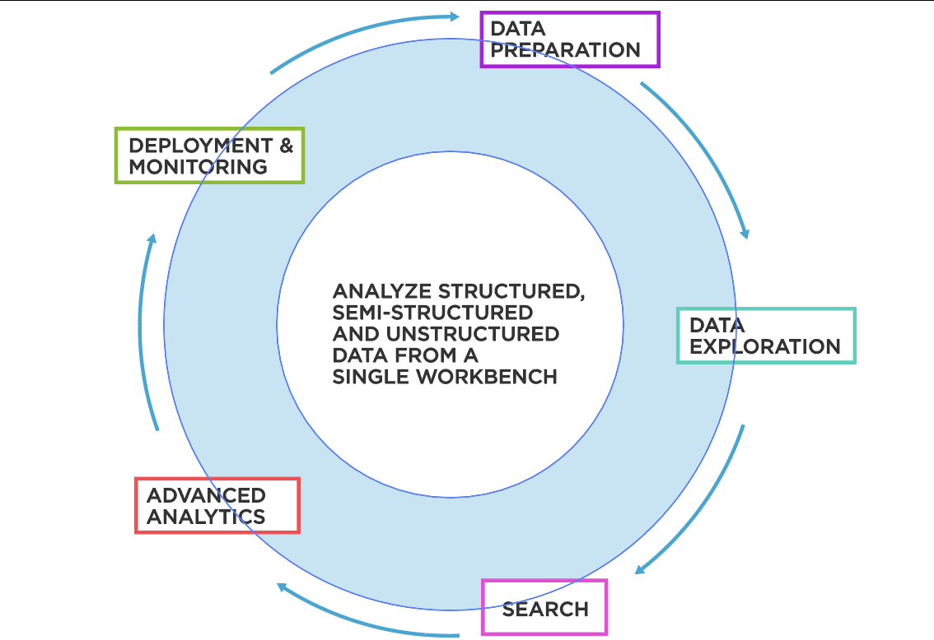
Benefits of Creating an Analytical File in Predictive Analytics
Data Exploration: Analytical files enable in-depth data exploration and understanding.
Data Cleaning and Standardization: An analytical file ensures data quality and consistency.
Efficiency and Scalability: Handling large volumes of data becomes easier and more efficient.
Reproducibility and Documentation: Analytical files provide a documented record for transparency and collaboration.
Model Performance and Interpretability: Well-constructed analytical files enhance model performance and deliver interpretable insights.

Slide 5
Strategic Blueprint: From Data to Decision
Understanding the Challenge: Define the business problem. Identifying top areas for cannabis store openings. Recognize the importance of a data-driven approach.
Data Assimilation: Import necessary datasets. Merge and consolidate data for a holistic view.
Exploratory Data Analysis (EDA): Dive deep into individual variables. Visualize distributions and relationships.
Feature Engineering & Selection: Correlation analysis to gauge variable importance. Employ stepwise forward, backward elimination, and sequential feature selection.
Modeling: Selection of predictive models suitable for the dataset. Training and optimizing models on the data.
Validation & Evaluation: Use advanced techniques like decile charts and Lorenz curves. Assess model accuracy and reliability.
Insight Extraction & Recommendations: Derive actionable insights from model predictions. Recommend the top 5 best store locations in Ontario.
Business Implementation: Strategize store openings based on recommendations. Monitor performance and recalibrate strategy as needed.

Slide 6
Stakeholder Value: The Business Imperative
Strategic Direction:
Aligns company's mission with actionable insights.
Ensures all stakeholders work cohesively towards a common goal.
Informed Decision-Making:
Data-driven insights offer clarity.
Minimizes risks, maximizes ROI.
Optimal Resource Allocation:
Ensures investments (time, money, manpower) are directed to the most promising areas.
Improves efficiency and profitability.
Brand Reputation:
Making informed, strategic decisions enhances brand image.
Positions Richard Boire Inc. as an industry leader in cannabis retail.
Future Growth:
Insights today lay the foundation for tomorrow's expansion.
Helps stakeholders anticipate and plan for future challenges.
Stakeholder Confidence:
Transparent, data-driven decisions instill confidence in investors, employees, and partners.
Bolsters company stability and long-term vision.

Slide 7
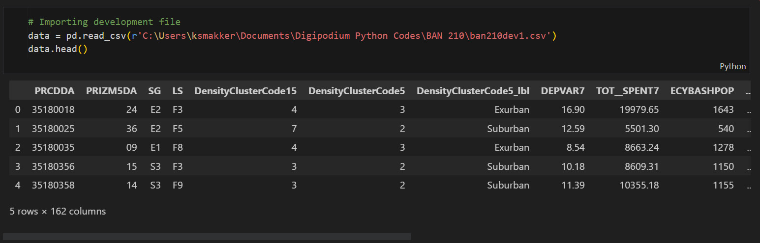
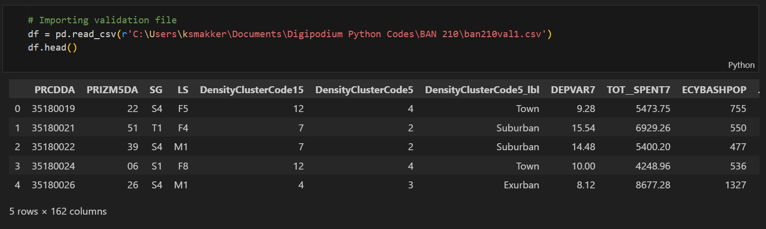
Dataset Overview
Development Dataset (ban210dev1.csv):
Number of Records: 3,823
Number of Variables: 162
Validation Dataset (ban210val1.csv):
Number of Records: 3,702
Number of Variables: 162
Dataset Description:
The dataset source offers a multifaceted view of consumer demographics and preferences in relation to the cannabis market. With variables ranging from geographic identifiers like the Dissemination Area (SGC Code) to market segmentation indicators such as PRIZM5 codes, it encapsulates various dimensions of the consumer landscape. Detailed descriptors for each variable, such as social group and life stage classifications, provide depth, ensuring a comprehensive understanding of potential cannabis consumers. This rich dataset lays the foundation for data-driven decision-making, enabling Richard Boire Inc. to strategically position its stores for maximum sales potential.

Slide 8
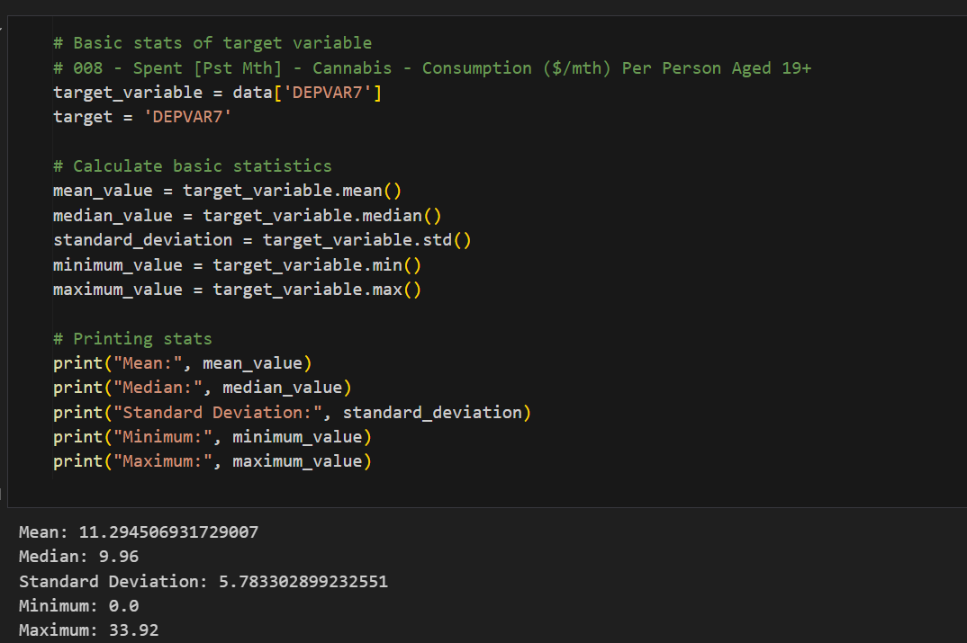
Detailed Statistics of Target Variable-DEPVAR7
Key Statistics:
Count: 3,823 records
Mean: 11.29
Median (50th Percentile): 9.96
Mode: 4.24
Standard Deviation: 5.78
Variance: 33.45
Minimum Value: 0.00
1st Quartile (25th Percentile): 7.44
3rd Quartile (75th Percentile): 14.50
Maximum Value: 33.92
The target variable, DEPVAR7, exhibits a diverse range of values, spanning from 0.00 to 33.92, with an average measure around 11.29. The data's dispersion, indicated by a standard deviation of 5.78, suggests varying levels of cannabis sales or activity across different regions or scenarios. Notably, the mode of 4.24, being considerably lower than both the mean and the median (9.96), hints at a substantial segment of data points clustering around this lower value. This could signify regions or situations with baseline or common sales levels. The broad spread between the quartiles further underscores the variability in the dataset, emphasizing the different market dynamics and the potential challenges and opportunities in identifying optimal store locations.
These statistics provide a comprehensive view of the distribution of the target variable DEPVAR7, highlighting its central tendency, dispersion, and overall range. This foundational understanding aids in building predictive models and deriving insights.

Slide 9
Detailed Statistics of Independent Variables
ECYACTUR (Unemployment Rate):
Mean: 6.54, Median: 6.20, Standard Deviation: 2.53, Variance: 6.40, Range: [0, 25.20].
SV00271 (Social Value - Social Darwinism):
Mean: 6.538869997384253, Median: 6.2, Standard Deviation: 2.5304210820602537, Minimum: 0.0, Maximum: 25.2
HSTA002B (Spent on - Other tobacco products and smokers' supplies):
Mean: 1.74, Median: 1.32, Standard Deviation: 1.37, Variance: 1.87, Range: [0, 8.70].
WSWORTHV (WealthScapes Net Worth – Value):
Mean: 1,210,874, Median: 921,522, Standard Deviation: 1,111,168, Range: [-1,722.08, 12,099,540].
WSD2AR (Debt:Asset Ratio):
Mean: 0.19, Median: 0.18, Standard Deviation: 0.08, Variance: 0.0066, Range: [0, 1.06].
These statistics provide an in-depth view of the distribution of the selected independent variables, capturing central tendencies, dispersions, and overall variability. Each variable offers unique insights into different facets of the dataset, paving the way for a comprehensive analysis.

Slide 10
Importance of statistics of these Independent Variables
ECYACTUR (Unemployment Rate) Importance: The unemployment rate serves as a significant economic indicator, reflecting the health of the job market in a particular region. A higher rate might suggest economic stagnation, possibly leading to reduced purchasing power. In the context of cannabis sales, understanding the unemployment rate can offer insights into the potential spending capacity of consumers in different areas.
SV00271 (Social Value - Social Darwinism) Importance: This metric provides a sociological perspective, shedding light on the societal values and beliefs prevalent in different regions. Areas with higher values might indicate a more competitive, individualistic population. Such insights can be pivotal in tailoring marketing strategies, understanding consumer behavior, and predicting the acceptance of cannabis products.
HSTA002B (Spent on - Other tobacco products and smokers' supplies)
Importance: Spending on tobacco products and related supplies can be a proxy for the prevalence of smoking habits in a region. Areas with higher spending might have a population more inclined towards smoking, suggesting potential receptiveness to cannabis products. It can also indicate disposable income dedicated to such recreational activities.
WSWORTHV (WealthScapes Net Worth - Value)
Importance: Net worth provides a snapshot of the wealth and financial health of households in a region. Higher net worth might indicate areas with affluent consumers, possibly leading to higher spending capacity. For a business like Richard Boire Inc., understanding regional net worth can help in pricing strategies and store placement.
WSD2AR (Debt:Asset Ratio)
Importance: The debt-to-asset ratio offers insights into the financial leverage and risk exposure of households. A higher ratio indicates more debt relative to assets, suggesting potential financial strain. In the context of cannabis sales, areas with high debt-to-asset ratios might exhibit cautious spending behavior, impacting sales potential.
In summary, these variables provide multifaceted insights into the economic, sociological, and financial aspects of different regions. Their statistics help in understanding regional variations, predicting consumer behavior, and making informed business decisions.

Slide 11
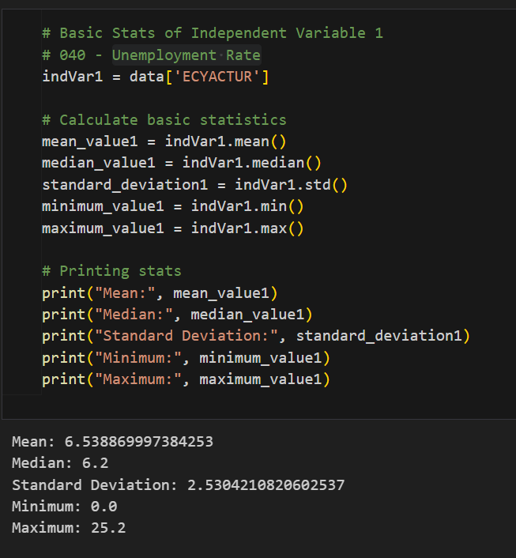
ECYACTUR (Unemployment Rate):
The average unemployment rate across regions is 6.54%, suggesting that on average, about 6.54% of the workforce is unemployed in the areas captured in the dataset.
With a median closely aligned with the mean at 6.20%, it indicates that the unemployment rate's distribution is relatively symmetrical.
A standard deviation of 2.53 implies that the unemployment rates across regions can vary by about 2.53 percentage points from the mean.
The range indicates that some areas enjoy full employment (0% unemployment), while others face a high unemployment rate of up to 25.20%. Such a broad range emphasizes the diversity in economic conditions across regions.

Slide 12
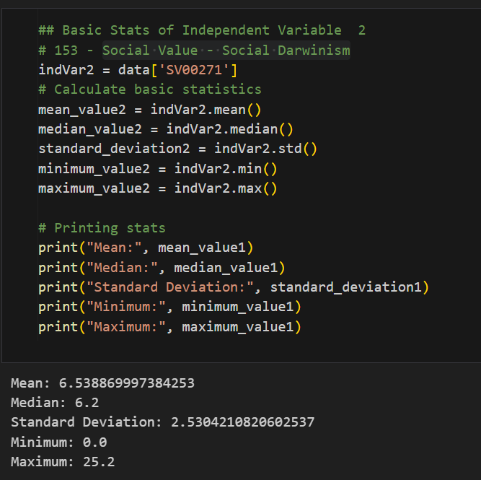
SV00271 (Social Value - Social Darwinism):
The average value for Social Darwinism stands at 6.54. This might indicate the general sentiment or belief level in Social Darwinism principles across the regions captured in the dataset.
A median value of 6.2, closely aligned with the mean, suggests that the distribution of values for this social metric is relatively symmetrical across the regions.
The standard deviation of 2.53 indicates moderate variability in Social Darwinism values across different regions. This could mean that while many regions might share similar values, there are some with significantly differing views.
The range, from a minimum of 0.0 to a maximum of 25.2, highlights a broad spectrum of societal values and beliefs. Some regions might not endorse Social Darwinism at all, while others might have a strong inclination towards it.

Slide 13
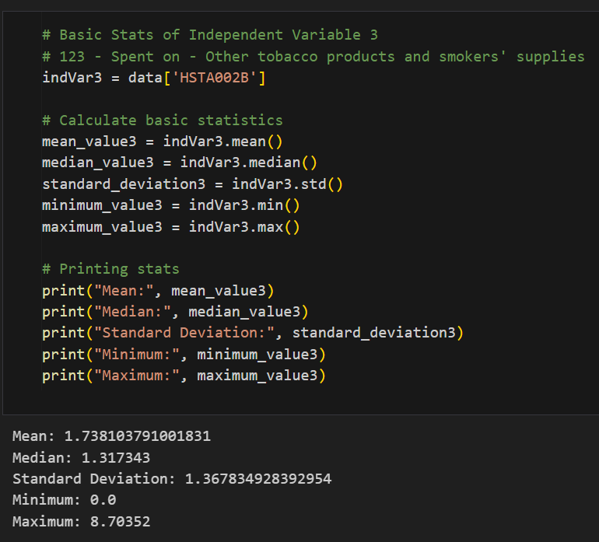
HSTA002B (Spent on - Other tobacco products and smokers' supplies):
On average, 1.74 units (could be in currency or other scale) are spent on tobacco products and related supplies.
The median being lower than the mean at 1.32 suggests a skew towards lower values, indicating that a significant number of regions might have lower spending.
The range from 0 to 8.70 units shows variability in spending habits, which can be crucial in understanding consumer preferences.

Slide 14
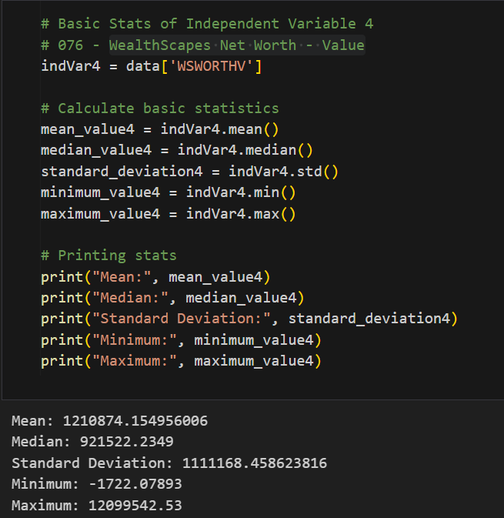
WSWORTHV (WealthScapes Net Worth - Value):
The average net worth across regions is a significant 1,210,874 units, suggesting relatively high affluence.
A median net worth of 921,522 implies that many regions might have a net worth below the average.
A vast standard deviation of 1,111,168 highlights the economic disparities across regions.
The range, from a negative net worth of -1,722.08 to an enormous 12,099,540, underscores the vast economic differences across various regions.

Slide 15
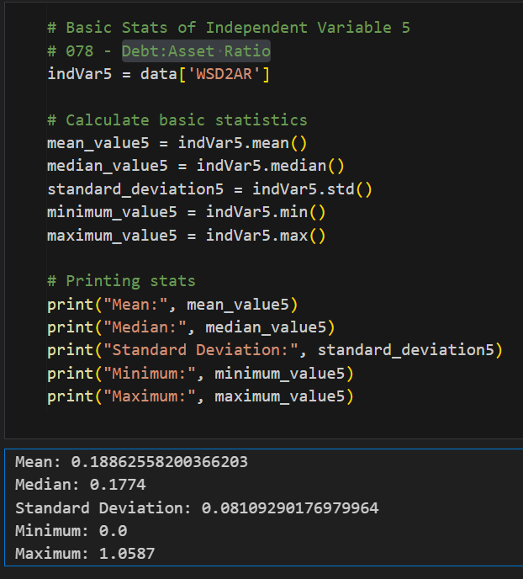
WSD2AR (Debt:Asset Ratio):
The average debt-to-asset ratio is 0.19, suggesting that for every unit of asset, there's a debt of 0.19 units on average across regions, indicating a relatively healthy financial stance.
The close mean and median values (0.19 and 0.18 respectively) hint at a balanced distribution.
With a standard deviation of 0.08, there's a moderate variation in the financial health of regions.
The range, from a minimum of 0.0 to a maximum of 1.06, indicates some regions are debt-free while others have a debt that surpasses their assets.

Slide 16
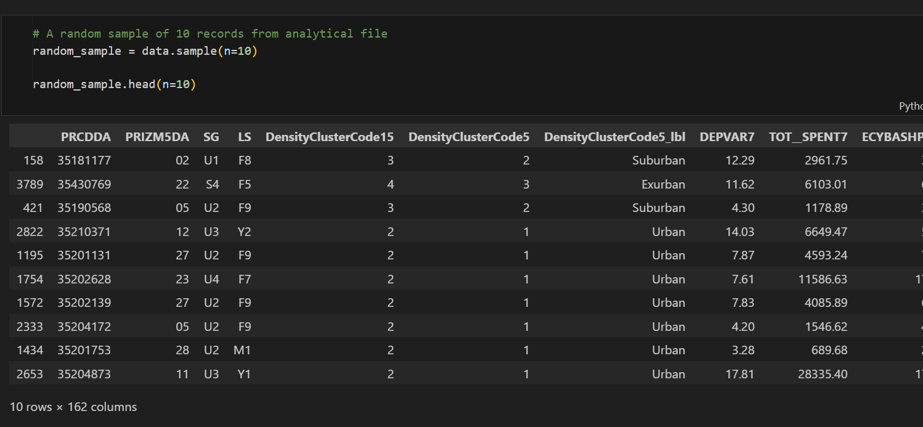
Random Sample from Dataset
Purpose: To offer a snapshot of the raw data from the analytical, giving viewers/stakeholders a tangible sense/overview of the dataset structure and the type of information, it contains.
Content:
A table showcasing 10 randomly selected records.
Each record provides insights into variables like unemployment rate, social values, spending on tobacco products, net worth, and debt-to-asset ratio, among others.
Importance:
Helps in familiarizing stakeholders with the actual data.
Demonstrates the diversity and breadth of information available for analysis.
Assists in setting context for subsequent analyses and discussions.

Slide 17
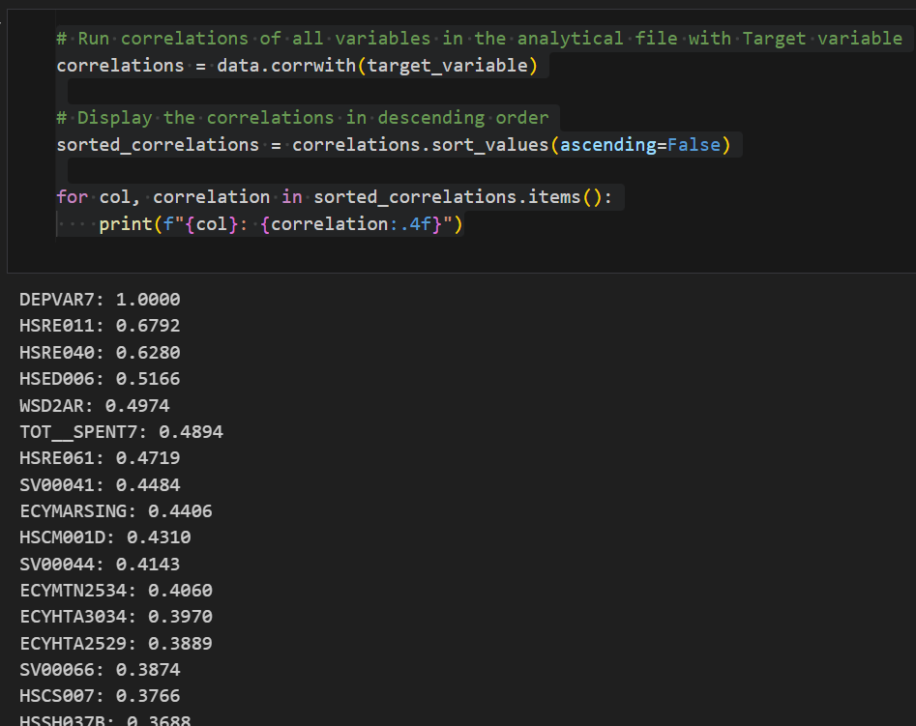
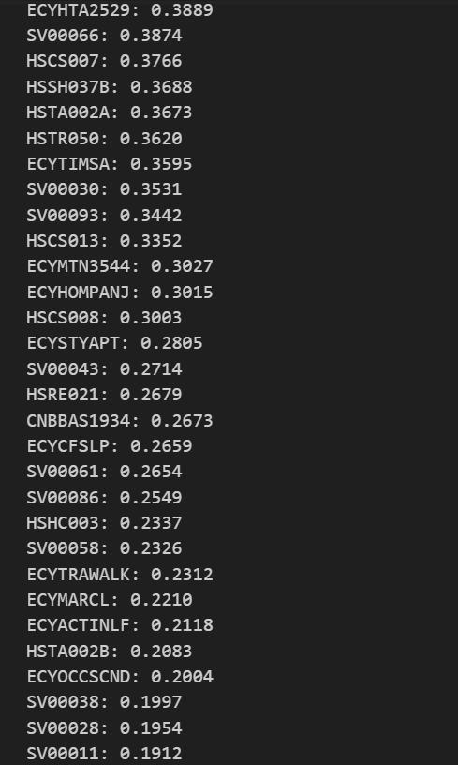
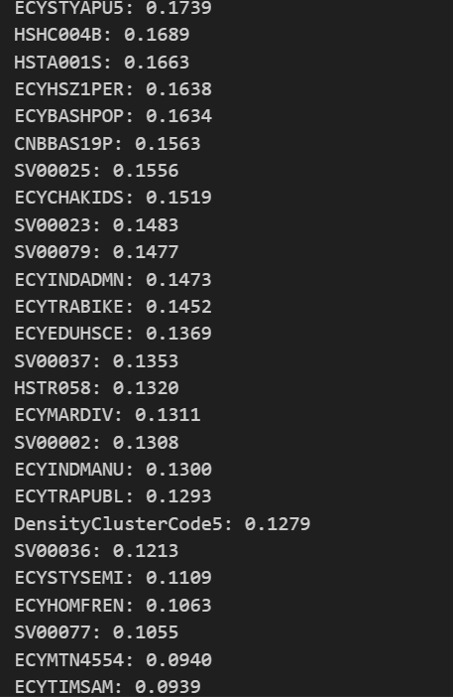
Introduction to Correlation Analysis
Purpose: To gauge the linear relationship between two variables. Understanding how independent variables relate to the target can guide feature selection and model building.
Definition: Correlation indicates the strength and direction of a linear relationship between two variables.
Range: Values lie between -1 (perfect negative correlation) and 1 (perfect positive correlation), with 0 indicating no correlation.
Importance in modeling: Helps identify potential predictors and avoid multicollinearity. Directs focus towards variables with significant relationships. Alerts to potential multicollinearity issues if independent variables are highly correlated with each other.

Slide 18
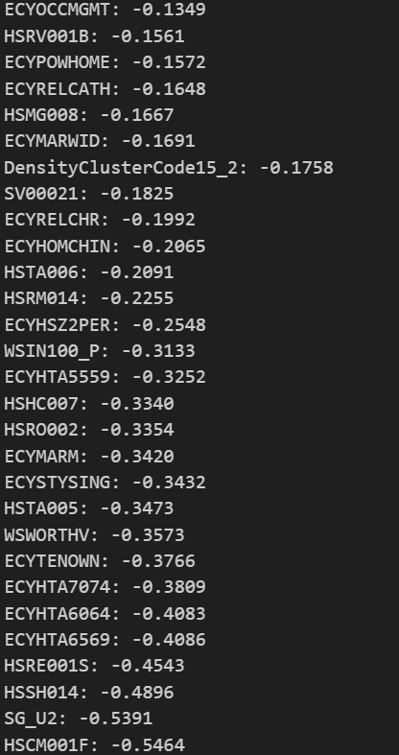
Key Findings from Correlation Analysis
Strong Positive Correlations:
HSRE011 (0.6792): Indicates that as this variable increases, DEPVAR7 (presumably cannabis sales) tends to increase. This variable might be a significant predictor.
HSRE040 (0.6280): Similarly, shows a strong positive relationship with the target.
HSED006 (0.5166): Another important variable to watch as it seems to influence the target positively.
Moderate Positive Correlations:
Variables such as WSD2AR (0.4974), TOT__SPENT7 (0.4894), and HSRE061 (0.4719) also have a positive relationship with the target but are not as strong as the top ones.
Strong Negative Correlations:
HSCM001F (-0.5464): Indicates that as this variable increases, DEPVAR7 tends to decrease. It could be a significant predictor but in the opposite direction.
SG_U2 (-0.5391): Another variable showing a strong negative relationship with the target.
Observations:
Several variables exhibit varying degrees of correlation, both positive and negative, with the target variable, DEPVAR7.
It's crucial to understand the context behind each variable to make sense of why they might be influencing cannabis sales.
Implication for Modeling:
Highly correlated variables are potential candidates for inclusion in predictive models.
Care should be taken for multicollinearity, especially if two independent variables are highly correlated with each other.

Slide 19
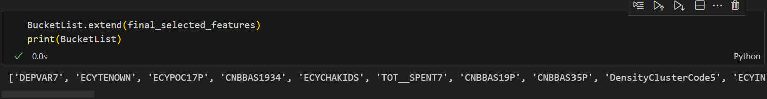
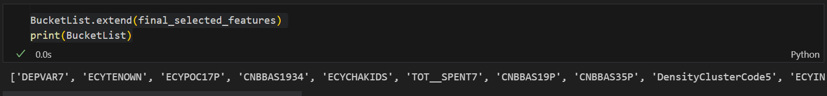
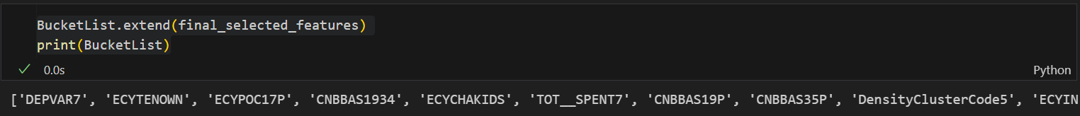
Introduction to Combined Forward & Backward Stepwise Selection
Objective:
To employ both Forward and Backward stepwise selection techniques in tandem to identify the most influential set of predictors for the model with respect to the target variable.
Combined Approach:
Benefits: This method capitalizes on the strengths of both techniques, ensuring a more comprehensive feature selection.
Process:
Step 1: Start with no predictors (Forward) and all predictors (Backward).
Step 2: Iteratively add/remove predictors based on their significance.
Step 3: Continue until the sets of predictors from both methods converge or no further improvement is observed.
Significance Levels:
The significance level for inclusion/exclusion of a feature is set (e.g., 0.01 for Backward and 0.01 for Forward).

Slide 20
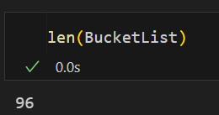
Iterative Binning and Feature Selection Process
Binning Strategy:
Total Features: 162
Bins Created: Each bin contains 40 features.
Process:
Step 1: Start with the first bin of 40 features.
Step 2: Apply combined Forward & Backward selection.
Step 3: Move the selected features to the next bin and add the next set of 40 features.
Step 4: Repeat the process for all bins.
Bin 1: First 40 features. After stepwise selection, X features selected.
Bin 2: X features from Bin 1 + next 40 features. Y features selected after stepwise selection.
Bin 3: Y features from Bin 2 + next 40 features. Z features selected.
Bin 4: Z features from Bin 3 + remaining features. Resulted in the final BucketList of 96 features.
Outcome:
From 162 features, the process narrowed down to a BucketList of 96 significant features.
Implication for Modeling:
This iterative approach ensures that the most influential features are retained, even as new features are introduced.
Helps in managing a large feature set and in systematically identifying the most impactful predictors.

Slide 21
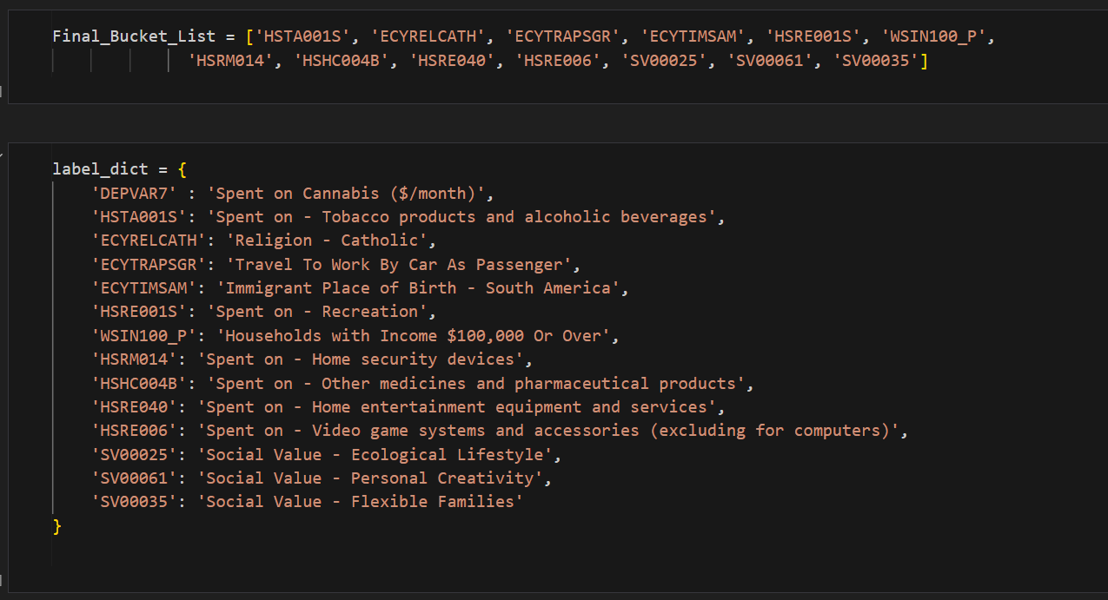
Introduction to Sequential Feature Selection
Objective:
A systematic approach to add or remove predictors based on the performance of a chosen estimator to enhance model accuracy.
Sequential Feature Selection:
Process:
Forward Selection: Starts without any feature and adds them one by one until an inclusion doesn't enhance the performance.
Backward Selection: Starts with all features and removes them one by one.
Floating: Allows adding and removing of features at each step, enhancing the selection process.
Advantages:
Reduces overfitting.
Enhances generalization.
Reduces training time.
Implementation:
Features are chosen from the Bucket List, which is the result of the combined Forward & Backward selection in bins.
A linear regression model is used as the estimator.

Slide 22
Final Features from Sequential Feature Selection
Selected Features:
Spent on Tobacco and Alcoholic Beverages - Indicates consumer habits related to controlled substances.
Religion - Catholic - May suggest cultural or societal attitudes towards cannabis.
Travel To Work By Car As Passenger - Could indicate socio-economic factors or urban vs. suburban living.
Immigrant Place of Birth - South America - Highlights possible cultural or regional influences on cannabis spending.
Spent on Recreation - A reflection of disposable income or lifestyle choices.
Households with Income $100,000 Or Over - Indicative of economic well-being and possibly disposable income.
Spent on Home Security Devices - Might suggest security-conscious consumers or those with properties to protect.
Spent on Other Medicines and Pharmaceutical Products - Indicates health-conscious consumers or those with medical needs.
Spent on Home Entertainment Equipment and Services - Reflects recreational habits and disposable income.
Spent on Video Game Systems and Accessories - A possible reflection of a younger demographic or tech-savvy consumers.
Social Value - Ecological Lifestyle - Shows a preference for sustainable and green living.
Social Value - Personal Creativity - Reflects a consumer's value on personal expression and creativity.
Social Value - Flexible Families - May indicate modern family structures or values.
Feature Reduction:
From the BucketList of 96 features, Sequential Feature Selection was applied to distill the list to the top 14 predictors that are deemed most influential for the target variable.
Implication for Modeling:
These 14 features capture a diverse set of consumer habits, values, and demographics.
Integrating these into the model will likely capture the nuances of cannabis spending behavior effectively.

Slide 23
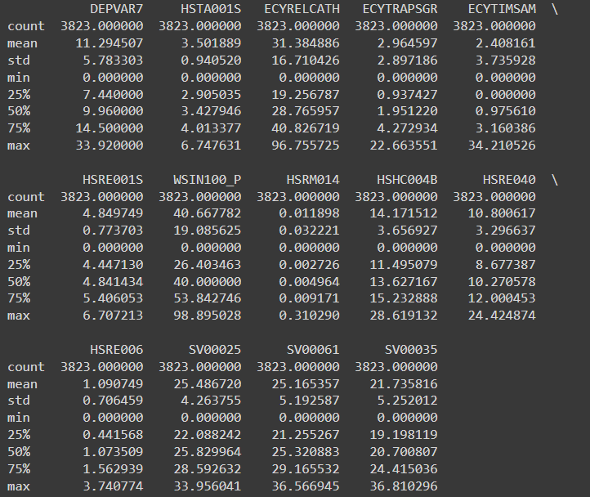
EXPLORATORY DATA ANALYSIS
Exploratory Data Analysis (EDA) is a critical step in the data analysis process that involves examining and summarizing data sets to gain insights, detect patterns, identify anomalies, and formulate hypotheses. It is usually one of the first steps taken after data collection and before more formal statistical modeling or hypothesis testing. EDA helps data analysts and scientists understand the characteristics of the data they are working with, which in turn informs the subsequent analysis and decision-making processes.
Process in EDA:
Feature Selection and DataFrame Creation
Binning the Features
Calculating Binned Means
Visualization using Scatter Plots
Plot Labels and Titles
Displaying Plots
Importance Of EDA:
EDA acts as a foundation for successful predictive analytics by helping analysts understand the data's characteristics, relationships, and potential challenges. It ensures that the subsequent steps of feature engineering, model selection, and evaluation are well-informed, leading to more accurate and reliable predictive models.

Slide 24
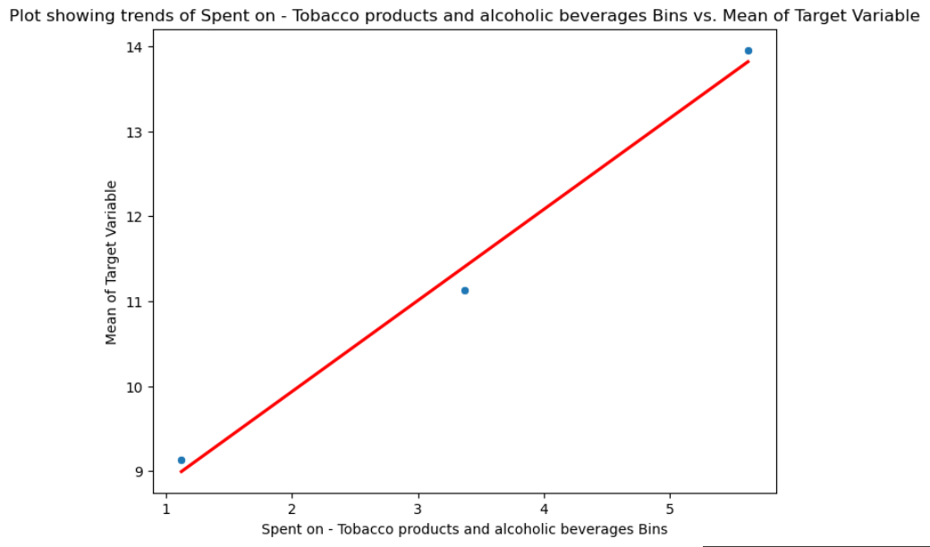
Key Features for EDA:
selected features = ['HSTA001S', 'ECYRELCATH', 'ECYTRAPSGR', 'ECYTIMSAM', 'HSRE001S', 'WSIN100_P', 'HSRM014', 'HSHC004B', 'HSRE040', 'HSRE006', 'SV00025', 'SV00061', 'SV00035’]
Spent on - Tobacco products and alcoholic beverages and Spent on Cannabis
This unexpected correlation suggests a potential co-occurrence in consumer preferences, where higher spending on one substance aligns with higher spending on anot"An interesting finding emerges from our analysis, revealing a positive correlation between expenditures on 'Tobacco products and alcoholic beverages' and spending on 'Cannabis.' This unexpected correlation suggests a potential co-occurrence in consumer preferences, where higher spending on one substance aligns with higher spending on another. This insight prompts us to explore the sociodemographic factors driving these patterns and consider their implications for targeted marketing or intervention strategies."her. This insight prompts us to explore the sociodemographic factors driving these patterns and consider their implications for targeted marketing or intervention strategies.

Slide 25
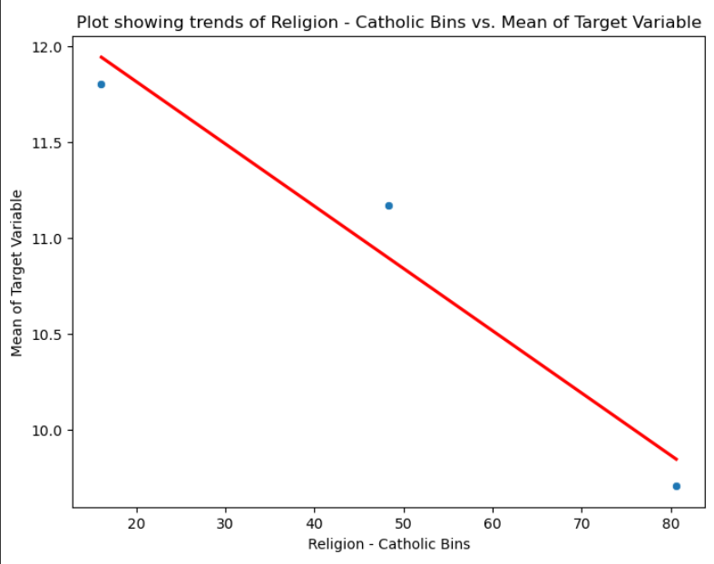
Religion - Catholic and Spent on Cannabis ($/month)
Our analysis has revealed an intriguing negative correlation between individuals identifying as 'Catholic' in the 'Religion' category and their spending on 'Cannabis.' This finding suggests a possible influence of religious beliefs on spending behavior related to cannabis consumption. Exploring the underlying sociocultural factors contributing to this correlation could provide valuable insights for targeting public health campaigns, policy decisions, and marketing strategies within specific religious communities.

Slide 26
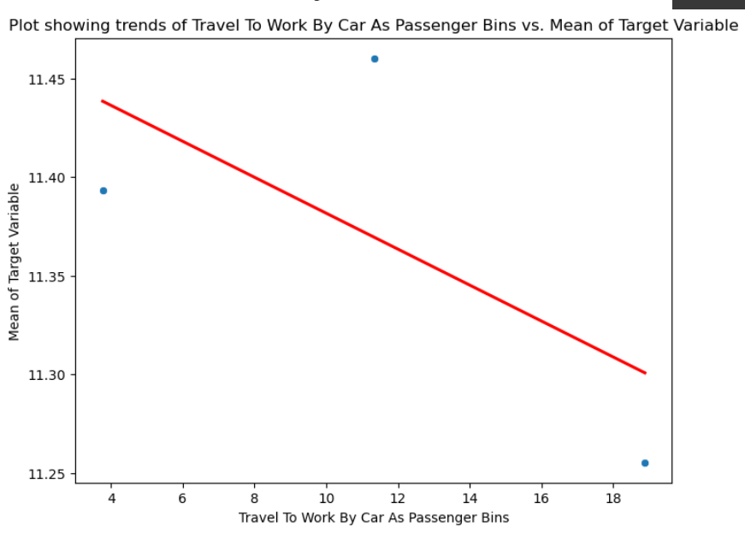
Travel To Work By Car As Passenger and Spent on Cannabis ($/month)
From our analysis, showcasing a negative correlation between individuals who commute 'To Work By Car As Passenger' and their spending on 'Cannabis.' This correlation might suggest a potential association between shared commuting practices and spending choices. Further investigation into the demographic and lifestyle characteristics of those who share car rides could unveil insights into social behaviors that influence cannabis expenditures. Such insights could be valuable for targeted educational campaigns and transportation policies

Slide 27
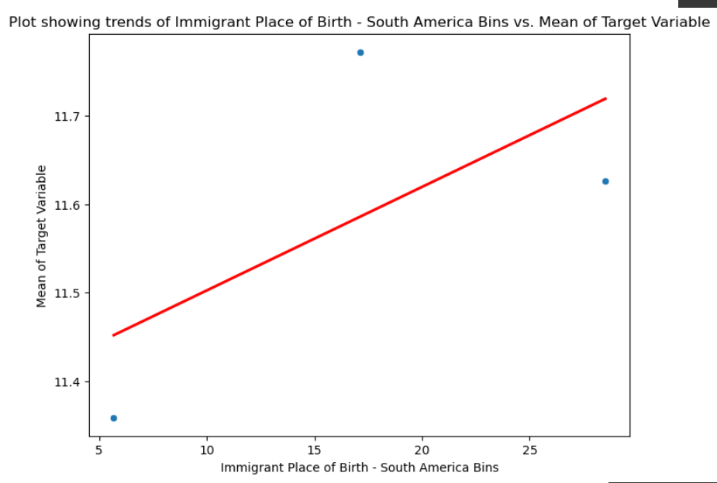
Immigrant Place of Birth - South America and Spent on Cannabis ($/month)
Our analysis reveals a noteworthy positive correlation between individuals originating from 'South America' as their place of birth and their spending on 'Cannabis.' This correlation implies a potential connection between cultural backgrounds and cannabis consumption behaviors. Considering the distinct cultural norms and regulatory environments in South American countries, our findings prompt us to explore how these factors might influence spending patterns among immigrant populations. These insights can guide culturally sensitive interventions, public health initiatives, and policy discussions related to cannabis usage.

Slide 28
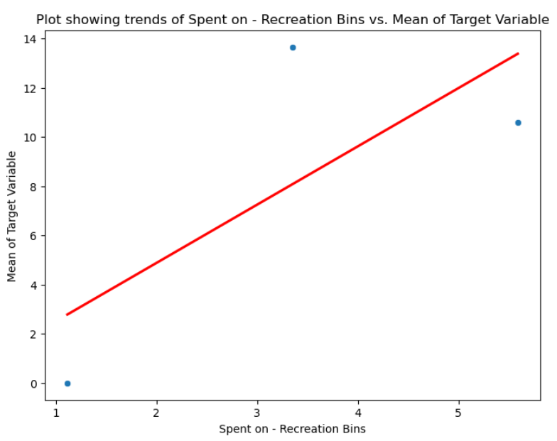
Spent on - Recreation and Spent on Cannabis ($/month)
This correlation suggests a potential connection between recreational preferences and cannabis consumption habits. It's plausible that individuals who allocate more resources to leisure activities may also exhibit higher expenditures on cannabis as part of their recreational choices. Understanding the motivations behind this correlation can offer valuable insights for targeted marketing strategies, lifestyle analysis, and consumer behavior studies in the context of both recreational activities and cannabis usage.

Slide 29
Households with Income $100,000 Or Over and Spent on Cannabis ($/month)
An intriguing observation emerges as we identify a negative correlation between 'Households with Income $100,000 Or Over' and 'Spent on Cannabis.' This finding suggests that higher-income households tend to allocate fewer financial resources toward cannabis consumption. Possible explanations include differing priorities, perceptions, or regulations surrounding cannabis expenditure within affluent households. This insight prompts us to explore the socio-economic dynamics shaping this relationship and their potential implications for consumer behavior, market strategies, and policy discussions.

Slide 30
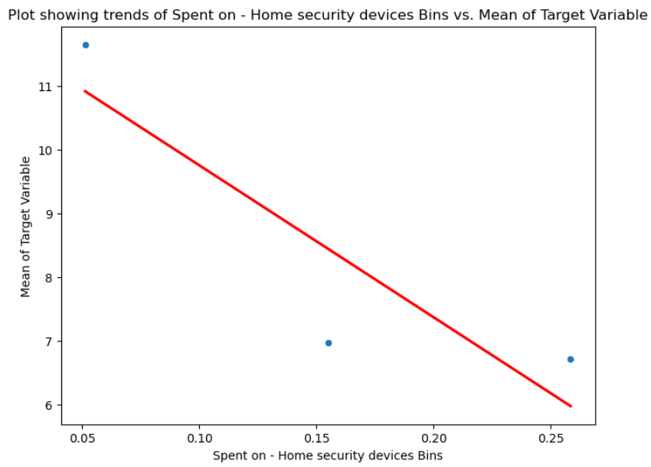
Spent on - Home security devices and Spent on Cannabis ($/month)
Our analysis reveals an intriguing negative correlation between 'Spent on - Home security devices' and 'Spent on Cannabis.' This finding suggests a potential trade-off between investments in home security and spending on cannabis-related products. Individuals who prioritize home security may allocate resources differently, potentially influencing their choices concerning cannabis expenditure. This insight prompts us to explore the underlying motivations and demographics driving this correlation, offering insights into lifestyle choices, security concerns, and potential intersections between these distinct consumer behaviors.

Slide 31
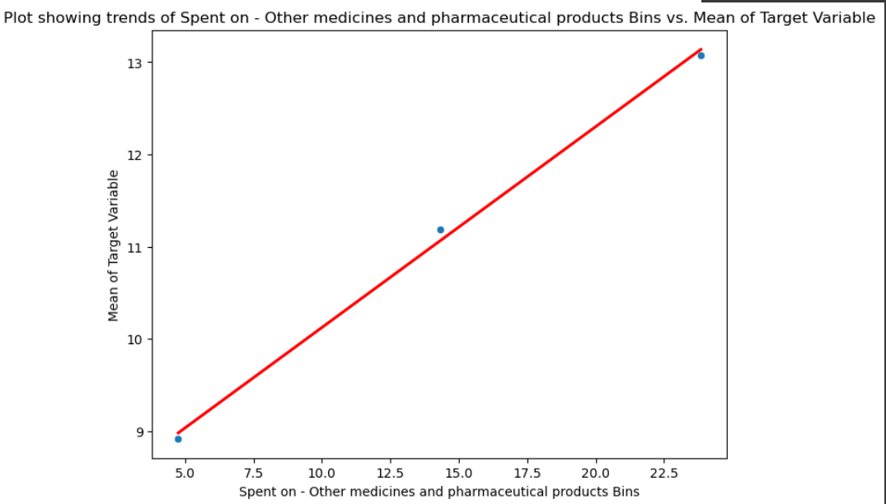
Spent on - Other medicines and pharmaceutical products and Spent on Cannabis ($/month)
This correlation suggests a potential link between health-related expenditures and cannabis consumption patterns. Individuals who allocate resources toward other medicines might also engage in spending on cannabis for various wellness-related reasons. Understanding the motivations behind this connection can provide insights into consumer behavior, potential complementary usage, and intersections between traditional and alternative health approaches.

Slide 32
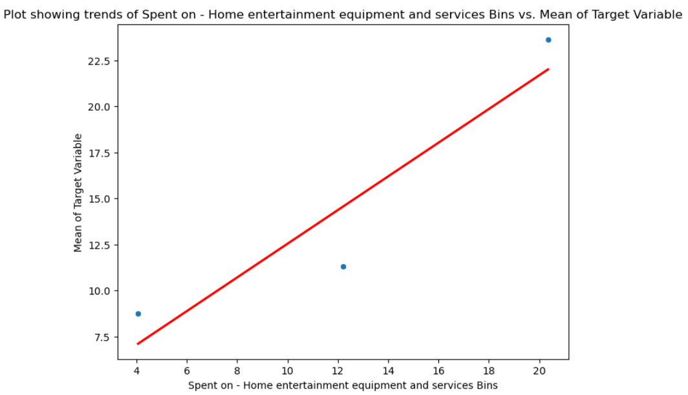
Spent on - Home entertainment equipment and services and Spent on Cannabis ($/month)
The positive correlation between spending on Home entertainment equipment and services and spending on Cannabis highlights a contemporary trend of blending leisure choices. As individuals invest in immersive home entertainment, they also exhibit an affinity for recreational experiences like cannabis, showcasing a modern fusion of relaxation and entertainment. This correlation suggests a growing preference for tailored leisure experiences. Consumers who allocate resources for advanced home entertainment are also inclined to embrace cannabis consumption, reflecting a desire to curate their leisure activities according to personal preferences.

Slide 33
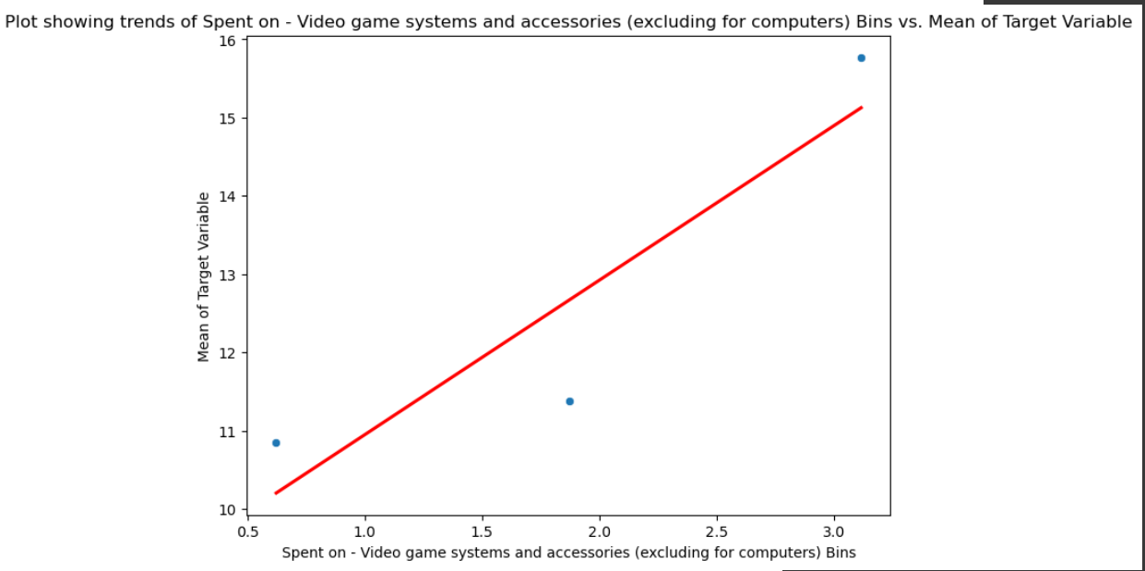
Spent on - Video game systems and accessories (excluding for computers) and Spent on Cannabis ($/month)
The positive correlation between spending on Video game systems and accessories (excluding for computers) and spending on Cannabis unveils a unique connection between contemporary recreational choices. As gamers invest in immersive gaming experiences, there's a simultaneous inclination towards exploring recreational activities like cannabis, showcasing an intriguing synergy of entertainment preferences. The correlation reflects evolving cultural norms and attitudes. With diminishing societal stigma around both gaming and cannabis, individuals are embracing these activities more openly, mirroring a broader shift towards accepting a range of leisure interests.

Slide 34
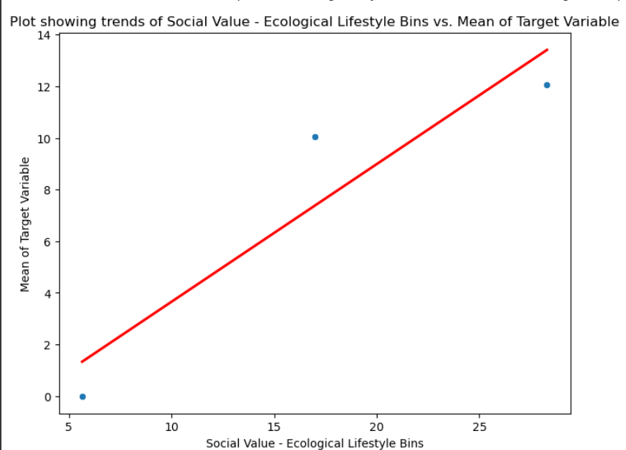
Social Value - Ecological Lifestyle and Spent on Cannabis ($/month)
The positive correlation between spending on an Ecological Lifestyle and expenditure on Cannabis sheds light on a noteworthy blend of values. Individuals embracing ecological choices may also express an affinity for sustainable recreational activities like cannabis consumption, exemplifying a fusion of eco-consciousness and leisure preferences. The correlation signifies a cultural shift towards integrated values. As societal norms evolve and environmental consciousness rises, individuals are embracing both ecological living and cannabis use more openly, reflecting a broader acceptance of diverse lifestyle elements

Slide 35
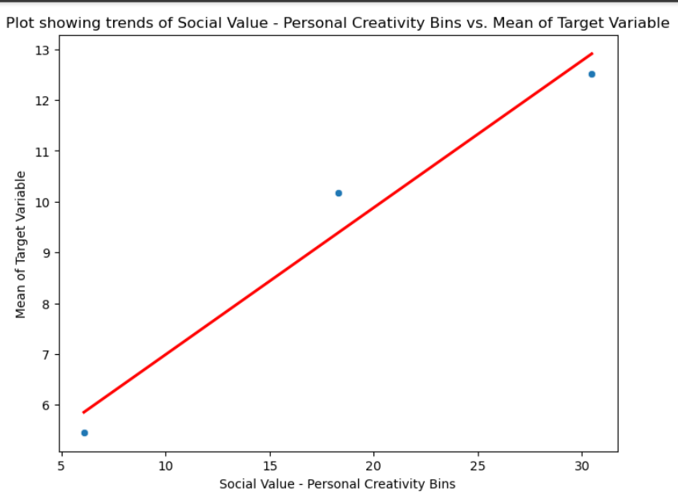
Social Value - Personal Creativity and Spent on Cannabis ($/month)
The positive correlation between spending on Personal Creativity and expenditure on Cannabis unveils an intriguing connection between self-expression and recreational choices. Individuals valuing personal creativity appear to embrace innovative leisure activities like cannabis consumption, showcasing a nexus where artistic expression and relaxation intertwine. The correlation reflects evolving cultural attitudes. As society becomes more accepting of both personal creativity and cannabis, individuals are more comfortable integrating these elements into their identities, symbolizing a broader shift towards embracing multifaceted leisure interests.

Slide 36
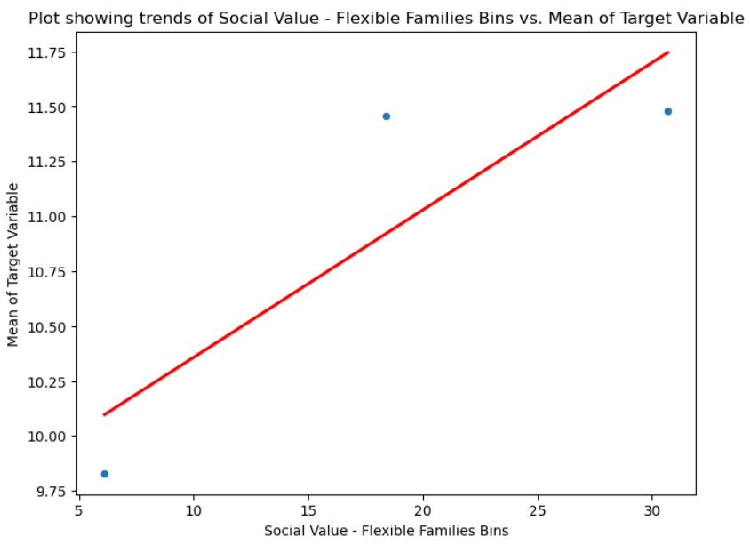
Social Value - Flexible Families and Spent on Cannabis ($/month)
The positive correlation between spending on Flexible Families and expenditure on Cannabis highlights an interesting connection between adaptable family dynamics and recreational preferences. Families valuing flexibility in their lifestyles may also embrace recreational activities like cannabis consumption, showcasing a trend of versatile leisure choices. The correlation reflects changing cultural norms. As societal acceptance of both flexible family structures and cannabis grows, families are more inclined to explore a variety of leisure pursuits, mirroring a broader acceptance of diverse lifestyle elements.

Slide 37
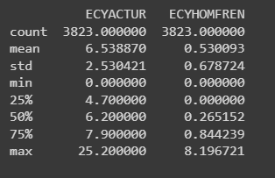
Anomalies and patterns observed
Binned Means Calculation: Calculating the mean of the target variable within each bin is a common approach. However, it's important to consider potential anomalies caused by imbalanced data distribution within bins. In cases where one bin has significantly fewer samples, its mean might be less representative.
Linear Regression Lines: Adding linear regression lines to the scatter plots can help visualize trends. However, keep in mind that the assumption of a linear relationship might not always hold true. Patterns might deviate from linearity, leading to misinterpretation if not carefully considered.
Labeling of Bins: The code doesn't explicitly mention how the bins are labeled or represented in the visualizations. Adding labels to the bins (e.g., low, medium, high) could enhance interpretation and help viewers understand the context of the plotted data.
Feature Significance: The code focuses on visualizing the correlation between features and the target variable's mean. To assess the significance of the correlations, statistical tests or further analysis might be needed, as the correlation strength could vary among features.
Missing Data Handling: The code doesn't address how missing data is handled in the analysis. Anomalies could arise if missing data significantly affects the calculated means or introduces bias in the insights drawn.
Overfitting Concerns: The code visualizes scatter plots with regression lines for each feature. While this can provide insights, it's important to avoid overfitting by adding too many complex lines that might not accurately represent the underlying patterns.
Contextual Understanding: Without context on the nature of the data or the business problem, it's challenging to assess whether the observed patterns or anomalies have practical significance. Understanding the domain and the goals of the analysis is crucial for accurate interpretation.

Slide 38
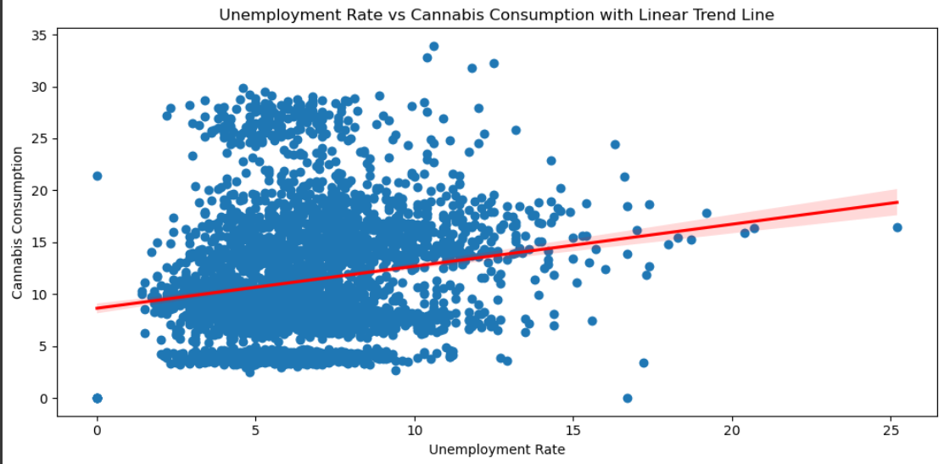
'Unemployment Rate' and 'Cannabis Consumption.' By adding a linear regression trend line to the scatter plot, the code aims to show whether there is a discernible linear trend between these two variables. The slope of the trend line (calculated as the rate of change) provides insight into the strength and direction of this relationship.
If the trend line slopes upwards from left to right, it suggests that as the 'Unemployment Rate' increases, 'Cannabis Consumption' tends to increase as well. Conversely, if the trend line slopes downwards, it indicates that as the 'Unemployment Rate' increases, 'Cannabis Consumption' tends to decrease. The slope's magnitude also provides information about the steepness of this relationship. The linear trend line helps visualize the general trend, but it's important to remember that a linear relationship might not always capture the full complexity of the data's underlying patterns.

Slide 39
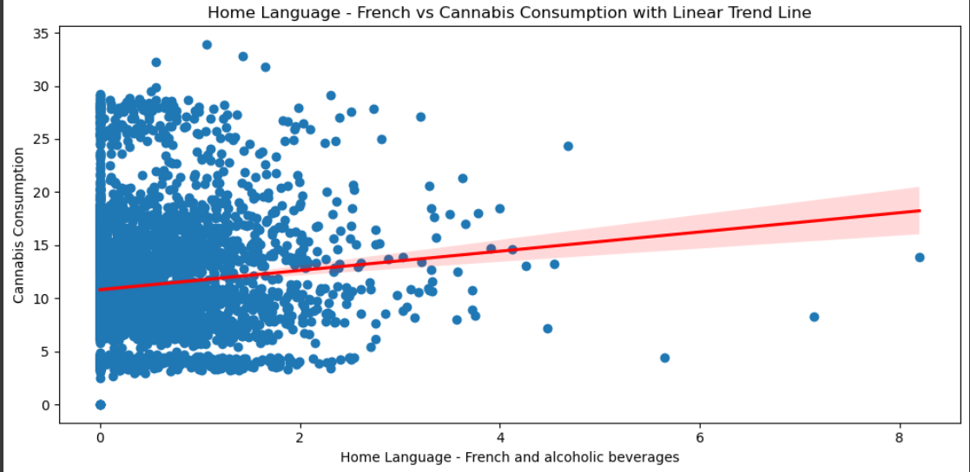
The pattern observed from this code lies in the relationship between 'Home Language - French' and 'Cannabis Consumption.' By adding a linear regression trend line to the scatter plot, the code visually demonstrates whether there's a discernible linear trend between these two variables. The slope of the trend line provides information about the direction and strength of the relationship.
If the trend line slopes upwards from left to right, it suggests that as the proportion of people speaking French at home increases, 'Cannabis Consumption' tends to increase as well. If the slope is negative, it indicates that as the percentage of French speakers at home rises, 'Cannabis Consumption' generally decreases. The magnitude of the slope provides insight into the steepness of this linear relationship. However, keep in mind that a linear trend line might not fully capture all complexities of the data's underlying patterns.

